Slide 1
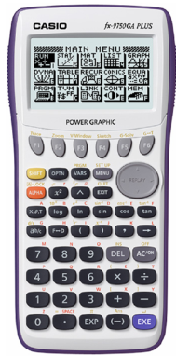
Casio graphics calculators and Chemistry
Use to solve
pH = -log [H⁺]
[H⁺=] = 10^{-pH}
 No Brain Too Small  CHEMISTRY 

Slide 2
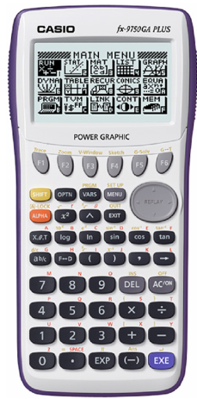







Finding –log of a number
Select this from menu
Example calculation -log 1x10⁻⁷ = 7
You press
Calculator displays 7
$$$$
 No Brain Too Small  CHEMISTRY 

Slide 3







Finding 10^{-pH} ( to calculate [H⁺])
Example – find the [H⁺] ions in a solution if the pH is 7
[H⁺]= 10^{-pH} or [H⁺] = invlog(-pH)
Calculator will display 1.E -07
Which means 1 x 10⁻⁷
(mol L⁻¹)
$$$$
 No Brain Too Small  CHEMISTRY 

Slide 4
Tips
Don’t forget to give your answer to the required number of significant figures as stated in the question.
For the unit standard this will be 3 s.f.
 No Brain Too Small  CHEMISTRY 

